Slide 1
IP Management and Patent Analytics;
Patent data as innovation and business intelligence indicator
Irene Kitsara
IP Information Officer, Access to Information and Knowledge Division

Slide 2


After the business idea/invention what?
What is the role of IP in successful management of innovation?
And how can patent analytics contribute to that?

Slide 3
Innovation cycle and IP management
Acquisition of IPRs?
Product/
Process Development
IP exploitation
Commercialization
Tech transfer
R&D investment/
Research/
Innovation
(stricto sensu)

Slide 4
How are decisions taken in a knowledge economy?
Cross-sectoral/interdisciplinary effort (Science/Policy/Economics/Business/Marketing) based on:
Policy/Regulations
Relevant market definition and analysis
Competitors activity and analysis
Economic/financial aspect
Risk
Data-driven decisions
Patent Information: important source of:
Technical
Business information
Legal

Slide 5
Decisions during the innovation cycle
Areas of research
R&D investment
Research collaborations?
Acquisition of IPR (publication/trade secrets vs. patenting)? Which IPR?
Commercialization of the product/process?
IP assets Management (patents and other IPR to keep/abandon/sell/license)
Decision types
Decision-makers profiles
Area of research
R&D investment
Research collaborations
Acquisition of IP Rights? Publication? Trade secrets?
Commercialization?
Management of IP/innovation
Government
R&D
Universities
Start-ups/spin-offs
SMEs
(IP) managers in the private sector
Inventors
Investors

Slide 6
Think of….
Companies such as Apple, but also think of start-ups…
How do they manage their innovation?
Apple is a heavy user of the IP system (patents, trademarks, designs…). It appears as applicant on 31495 patent applications on PATENTSCOPE (June 20, 2017)

Slide 7
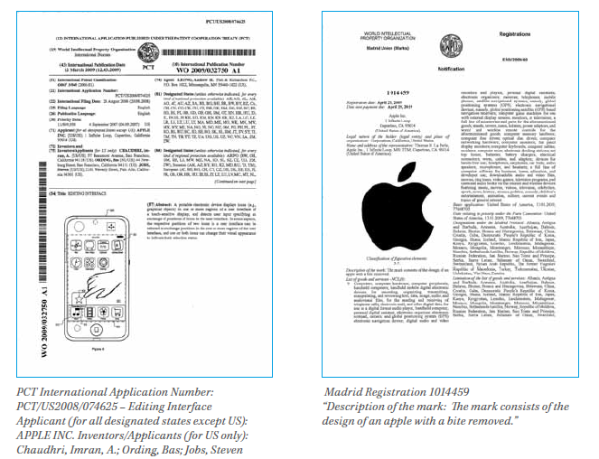
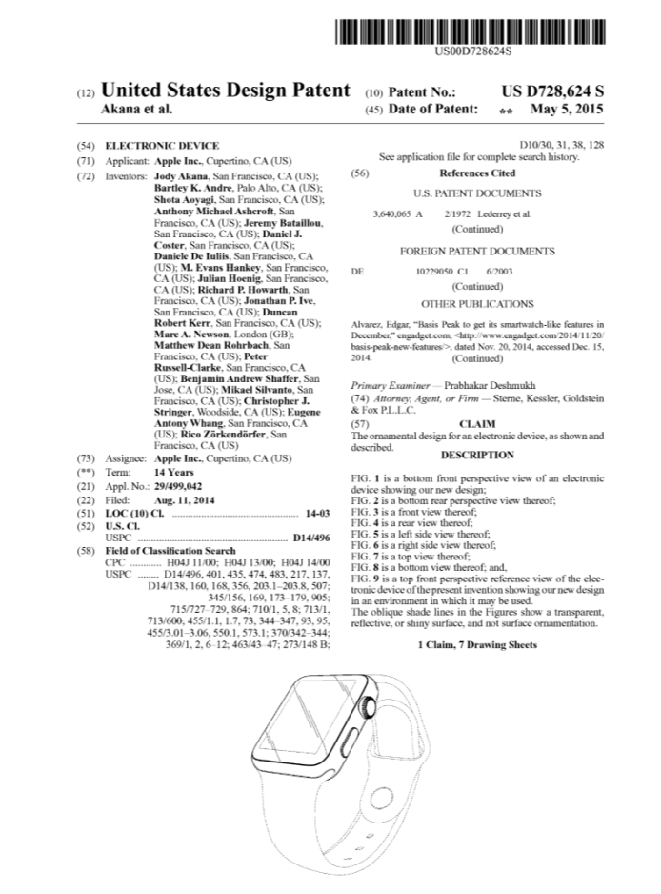
Examples of Apple IP rights
Success linked to innovation and the acquisition of IP rights:
asset
great negotiation power
increased competitive advantage and chances of success

Slide 8
The criteria of selection of IPR
Key considerations:
Technology domain
Preliminary protection of research results
Ease of commercialization
Market definition (existence/potential)
Level of competition – market position
Holistic approach for commercialization
Costs and funding
Risks

Slide 9
Other important aspects
Confidentiality agreements
Non-disclosure agreements
Joint research agreements
Licensing agreements (exclusive-non exclusive)
Framework – university/research facility/private sector
Particularities of national/relevant jurisdiction
Valuation of the invention/creation
IP rights bandle to introduce a product in the market

Slide 10
Facts of life…
IP rights are an asset which:
Improves the position of the inventor/creator and his negotiation power
Attracts more investors
Helps in the company´s valorization
Helps in the participation in or the creation of a market
Facilitates the competition management
Avoids problems linked to trade secrets

Slide 11


Open innovation and crowdfunding
Collaboration of Artificial Lab of ETH Zuerich and 10 different institutes and companies to develop one of the most modern robots
Based on open source research and crowdfunding

Slide 12
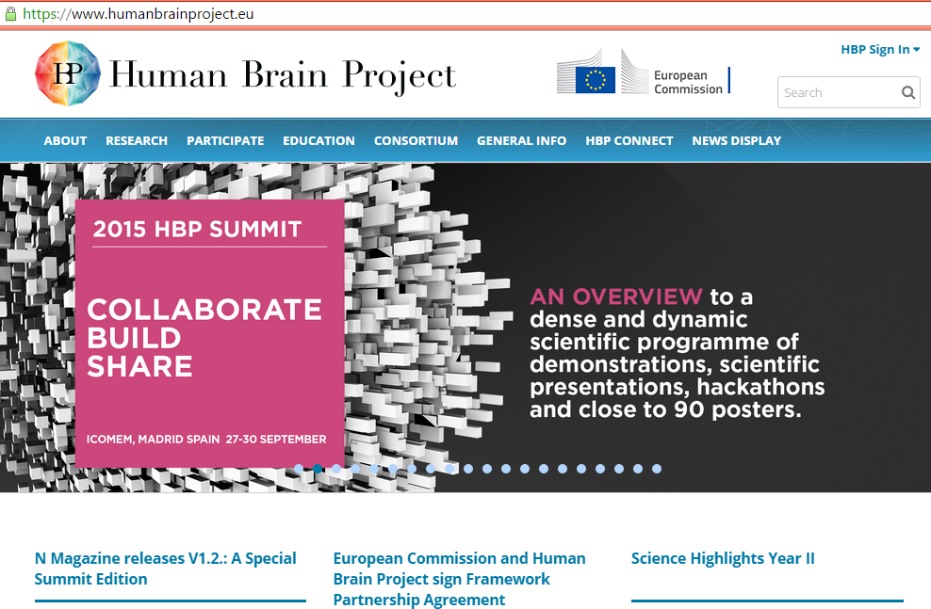
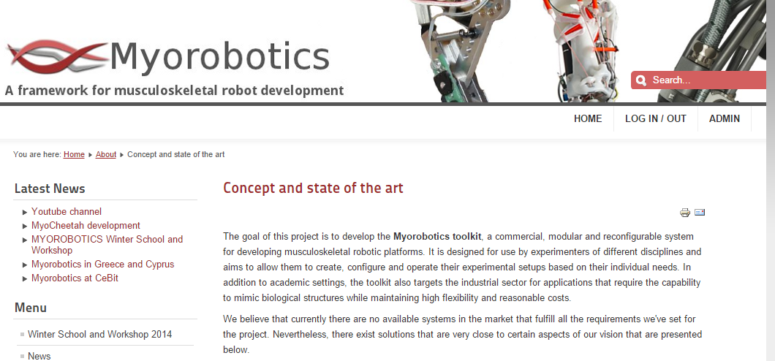
The success effect of RoBoy

Slide 13
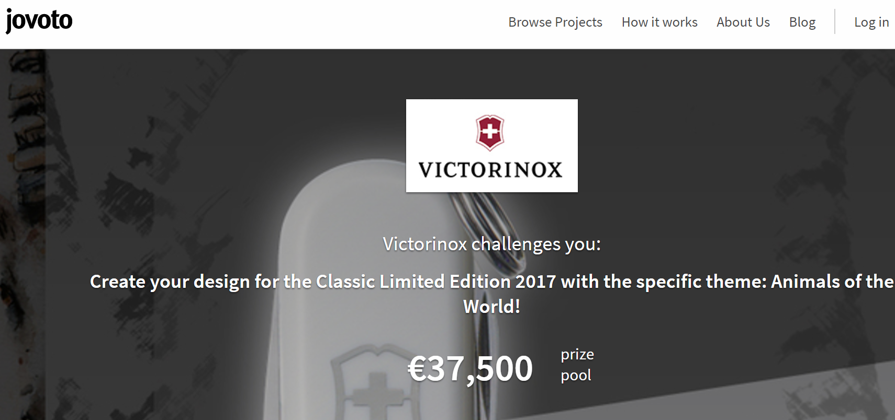

Options to get ideas – crowdstorming
Since 2014 Victorinox has been using Crowdstorming and www.jovoto.com for the design of its „limited edition“ Swiss knives

Slide 14

The „open access/source“ choice as part of innovation strategy
ETH Zurich developed a software
simulating explosions
„technical Oscar“ in special effects
No IP protection
Choice linked to the particularity of
the domain and the need for a quick
adoption of the technology by the
film sector
Cooperation of ETH Zurich
with Disney Research Zurich
Cooperation model: ETH Zurich and Disney
Share IP whenever they decide to go for IP protection
Scene from film « Battleship » using the software Wavelet Turbulence (Universal Pictures)

Slide 15
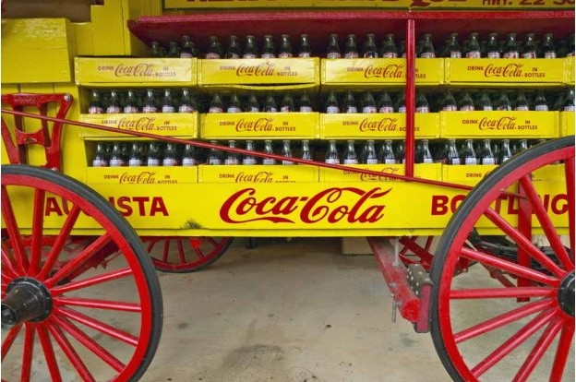
Trade secrets vs. patents
Longer protection
Reverse engineering should be
difficult
High copy/reproduction costs
Secret garanty (non-disclosure/,
confidentiality, non-competition agreements)
Coca-Cola example:
2006: effort to sell the trade secret to Pepsi

Slide 16

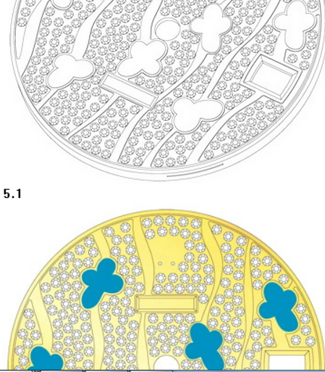
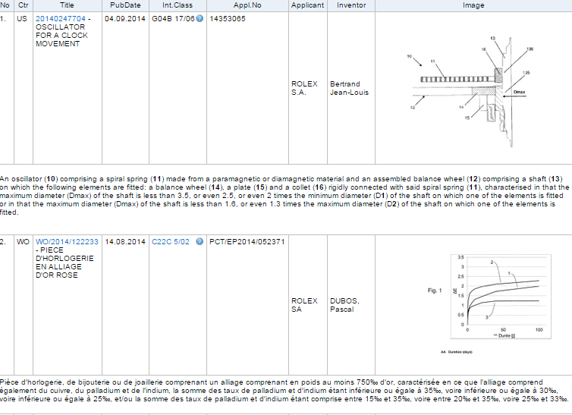
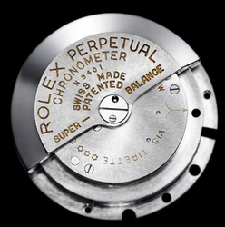

IP bandle – the example of Rolex
Industrial designs
Trademarks
Patents
www.rolex.com

Slide 17

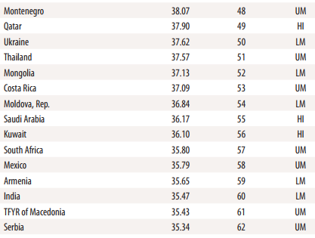

Slide 18
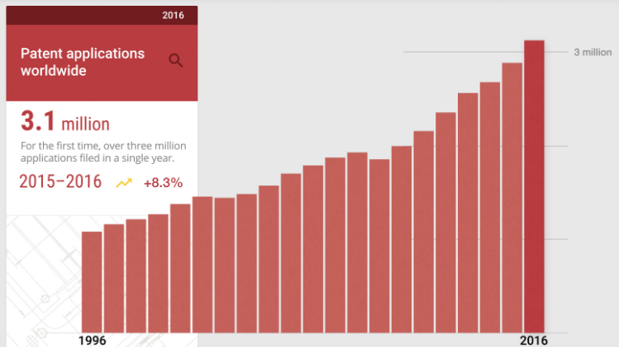
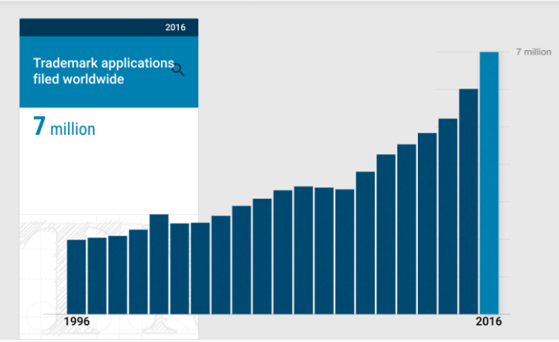
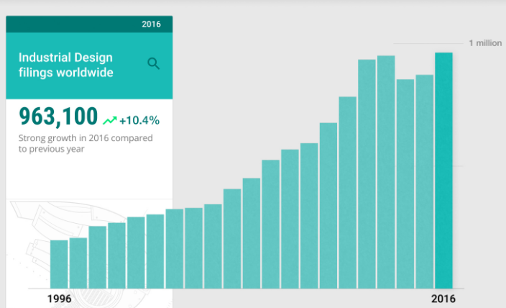
The use of the IP system

Slide 19
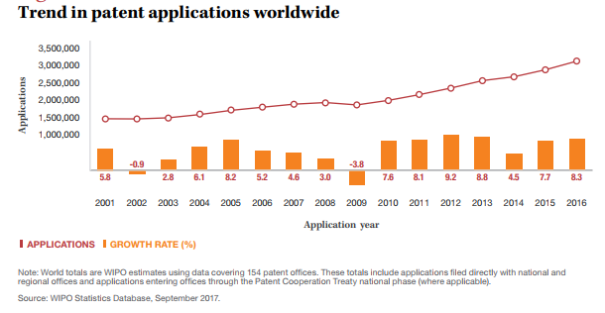

Growing importance of patent information
Increase in patent applications worldwide and in the information included therein
PATENTSCOPE: 67 mio patent documents
Challenge: access to the information and pertinence of the retrieved information

Slide 20
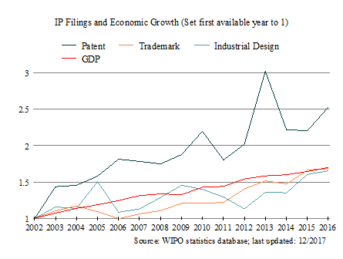
IP and Thailand

Slide 21
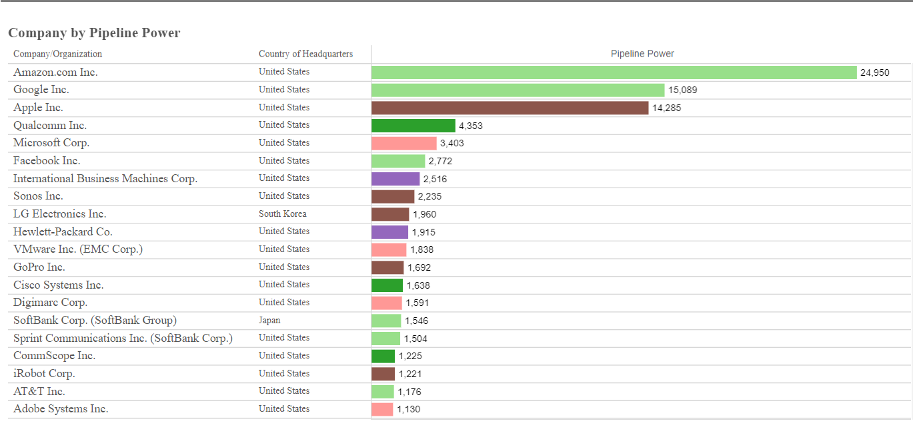
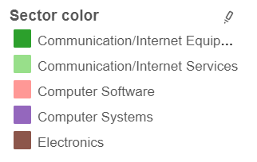
Companies’ patent portfolio and how they influence their sector
Source: IEEE Spectrum Patent Power Scorecards 2017
http://spectrum.ieee.org/static/interactive-patent-power-2017

Slide 22
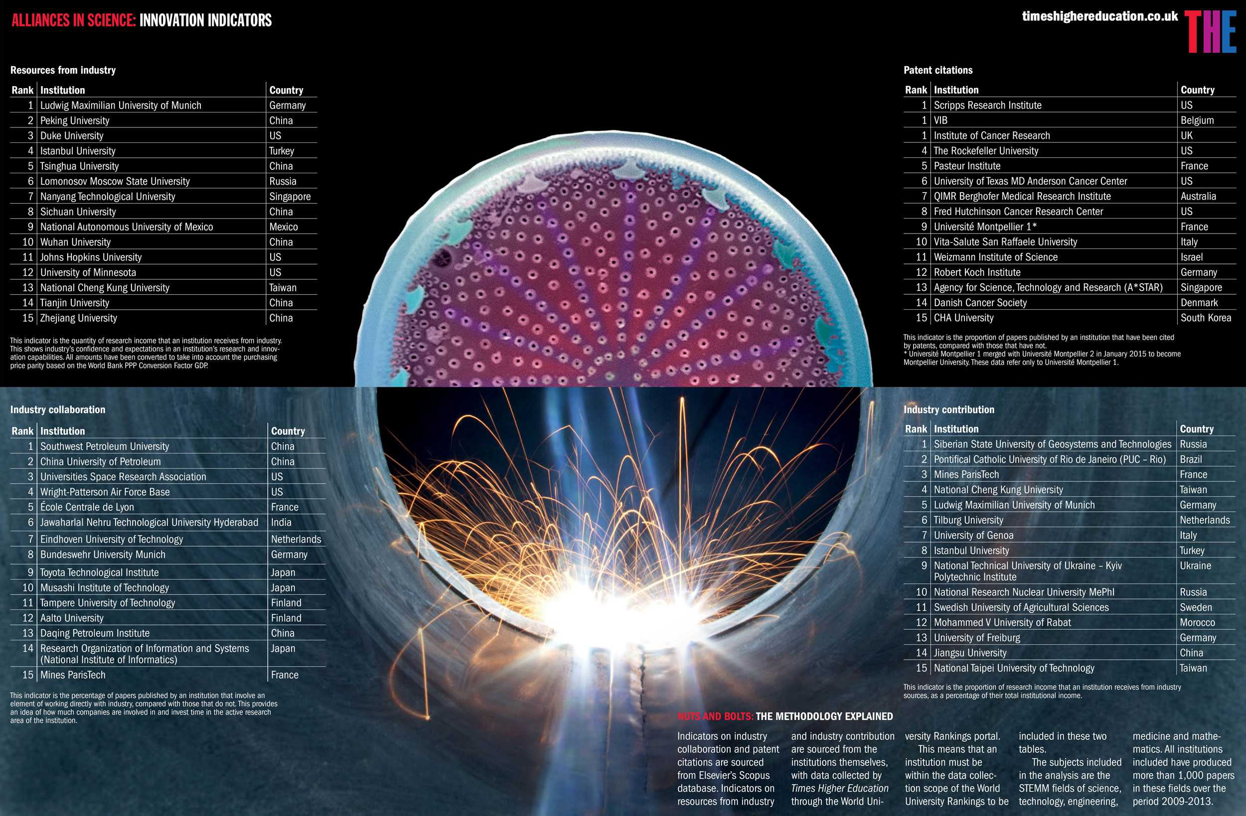
Decisions that lead to collaborations

Slide 23

What is used as an innovation indicator?
Innovation types:
product, process, organizational & marketing innovation
Patent data: innovation/ S&T output indicator

Slide 24

Patent-based indicators
Patents: structured data, appropriate for analysis
Information grouped by different criteria:
Patent classifications (technology, companies, organization types)
Patent citations
Internationalization of S&T
Patent value

Slide 25
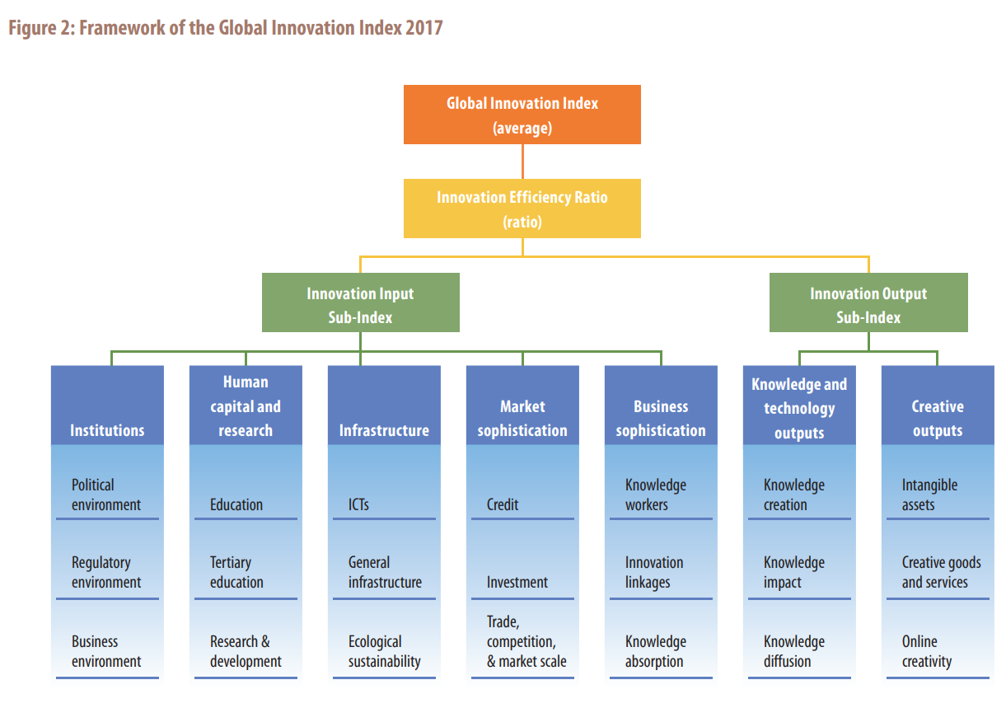

Global Innovation Index (GII)
www.wipo.int/edocs/pubdocs/en/wipo_pub_gii_2017.pdf

Slide 26
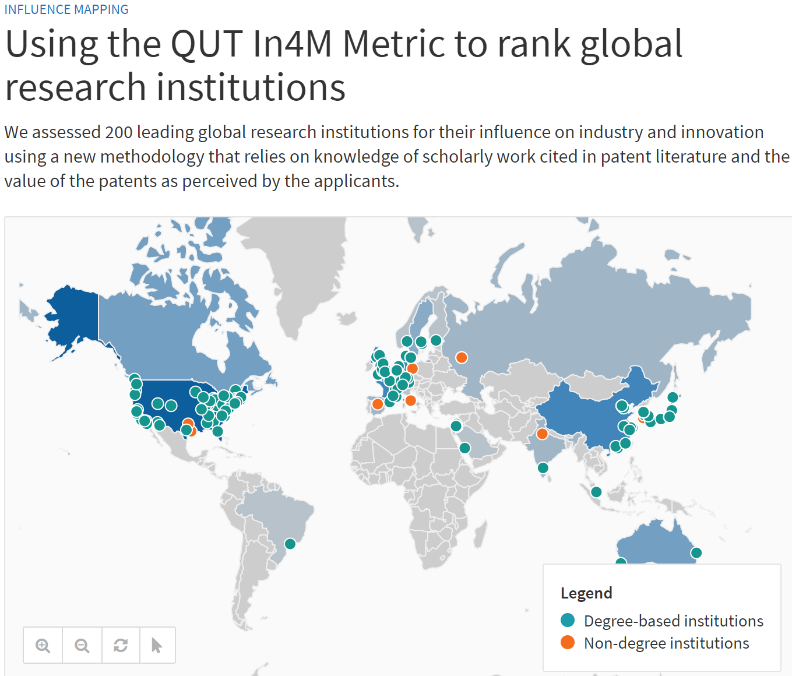

Slide 27
Some initial thoughts
What can we measure?
What is the value of measuring?
What are you trying to show?
Illustrate the data
Highlight a peak/something which stands out
First get clarity about what you want your audience to focus on
Choose the right visualization to make your case
Co-relation does not mean causation

Slide 28
Patent Information: fields which can be analyzed
Patent Documents
Publication/Application Numbers – which one and why?
Applicants
Inventors
Patent Classification
Citations
Other types of patent/business information
Legal Status Events
Change of ownership
Corporate trees/ affiliations
Licensing
Litigation

Slide 29
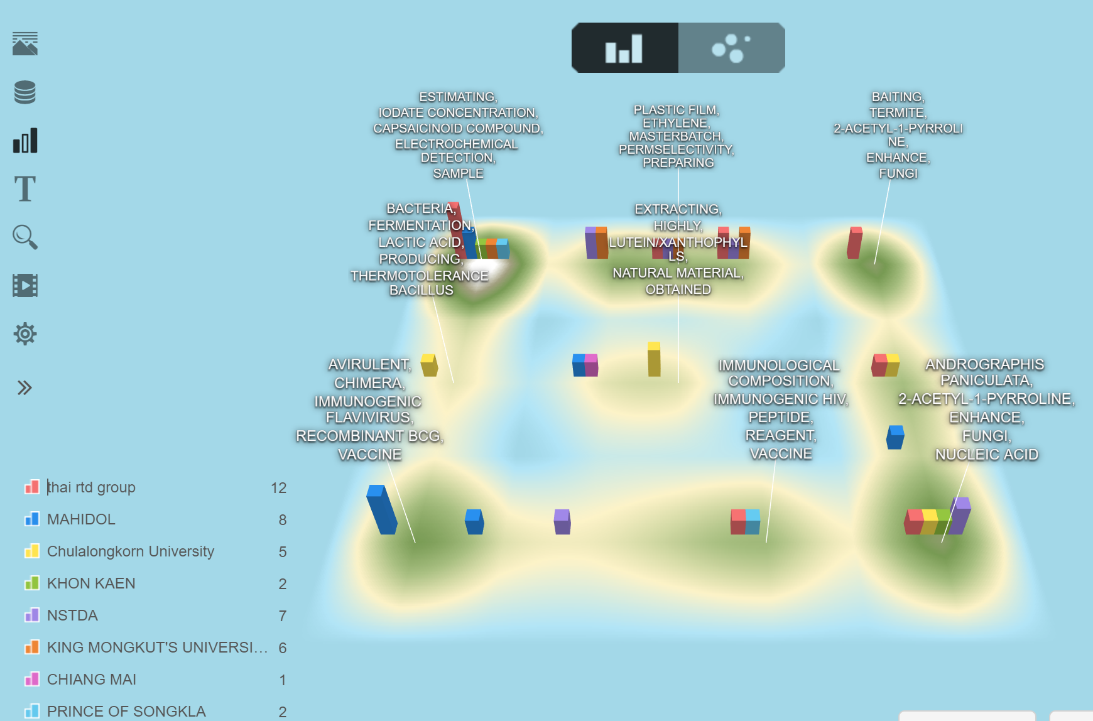
What can I analyze?
Technologies:
Patent classification codes
Text mining/concept analysis/clustering/network visualization
Importance and impact on thee field (citations, litigation, licensing)
Emerging/disruptive technologies and value (tricky!)
Identification of direct competitors/possible IPR infringements
Key patents/technologies
(citation analysis)

Slide 30
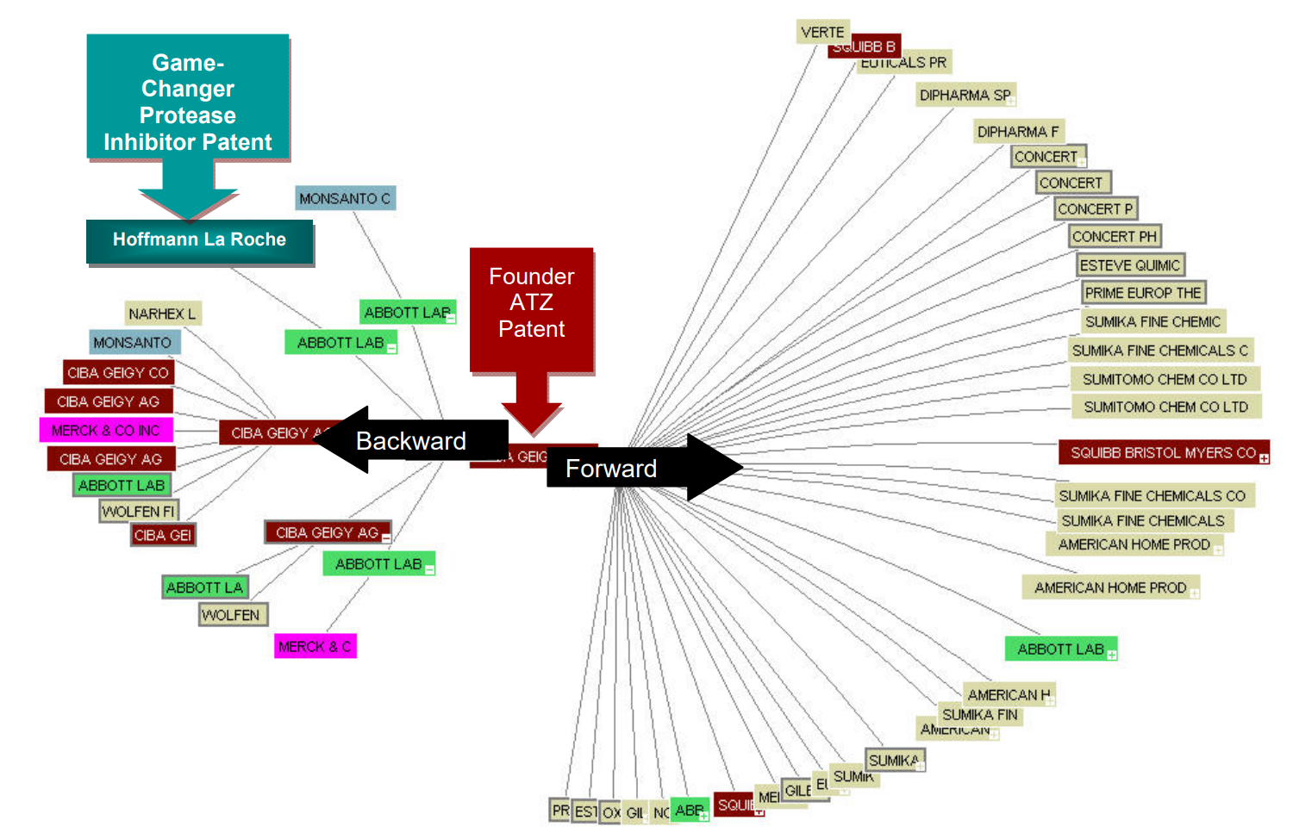
Citation analysis/network
Source:WIPO PLR on Atazanavir
Forward citations: impact of an invention/patent
Backward citations: assessment of degree of novelty

Slide 31
What can I analyze? (2)
Applicants/Inventors:
Top applicants/inventors
Co-occurances/collaborations/network analysis
Portfolio analysis
Afiliations/reassignments/licensing
Markets/Jurisdictions:
OFF, OSF
Filing strategy (indirect market analysis)
Dates and Legal Status (LS) information:
Portfolio age (part of patent/portfolio valuation)
Priority data
Technologies in the public domain
LS: patentability search vs. FTO search (exclude expired)

Slide 32
What do patent counts tell us? Perceptions & caveats
Differences across jurisdictions (patentable subject matter, backlogs, incentives to file a patent, examination quality)
Differences across cultures (patenting activity just one indicator of innovation)
Particularities of technology areas
Existing and missing counts (availability of data)
Difference in filing strategies and practices across areas of technology
Who are the dominant players? Real picture (corporate trees, M&As, afiliations of individuals to companies)
Different filing strategies based on size of companies (e.g. economies mainly with SMEs)

Slide 33
Value of patents and portfolios– which metrics used as indicators?
How disruptive is the technology – classification codes (outliers?), citations, emerging concepts
How impactful is the technology/invention - citations
Age of portfolio
Litigation around these technologies

Slide 34
How will I decide which data fields to analyze and how?
What is the purpose of my analysis? Where will it feed to?
General trends (filings over time)
Top applicants/inventors
Grants per family, percentage of families with grants
Geographical distribution, percentage of patent families with more than 1 family member, size of patent families
Citation analysis, identification of key patents/patent generations
What kind of new information/”Eureka moment” am I providing to the recipient of the analysis?
Don’t repeat known information
Anything surprising?

Slide 35
How do I choose my visualizations?
Same information can be presented in multiple ways. What is more appropriate, neater, more self-explanatory and looks more professional?
(-) pie charts, too intense colors, 3D bar charts
(-) too complex visualizations – simplicity is a virtue!
Experiment with different visualizations to see what looks better and shares the information in the most convincing way
We tend to focus on the information which stands out (peaks etc), and we tend to look for patterns/draw conclusions

Slide 36
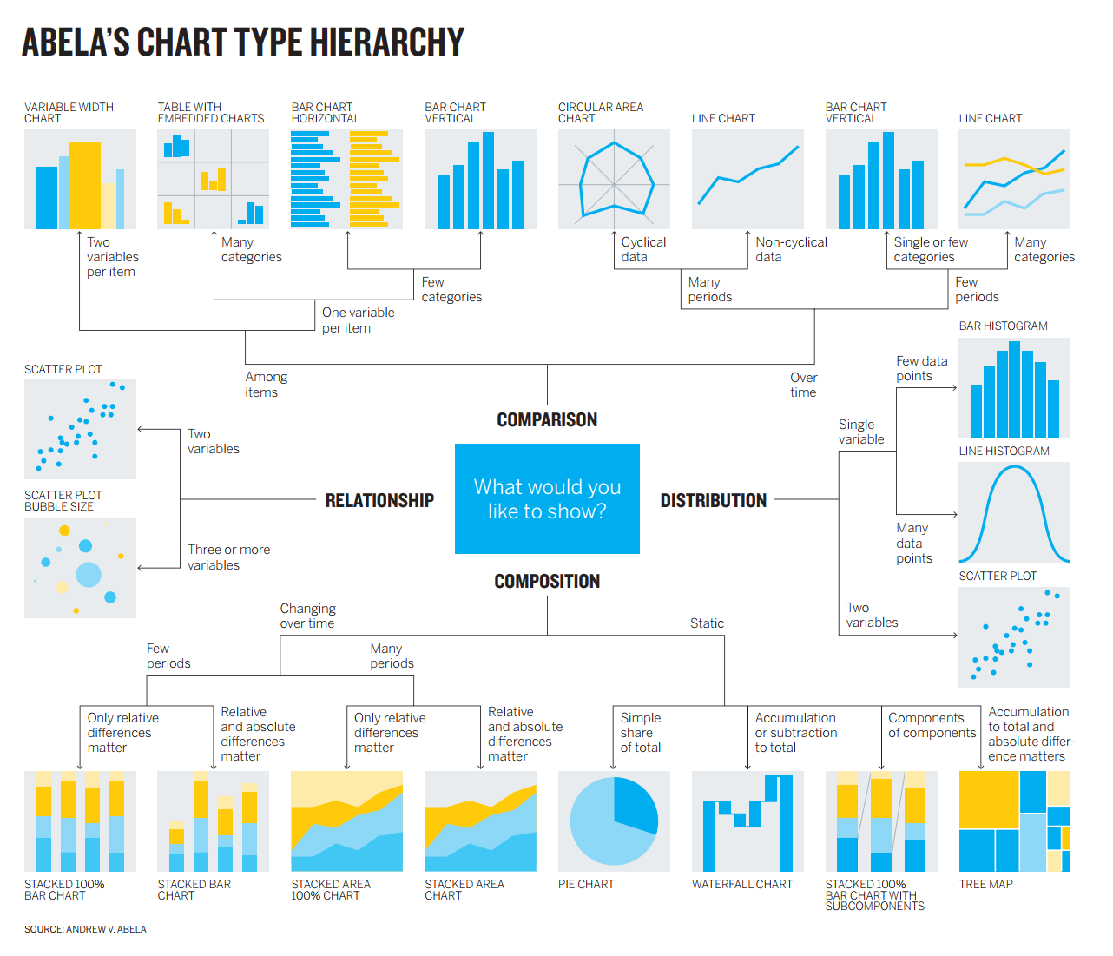
What do you want to show and how will you do it?

Slide 37
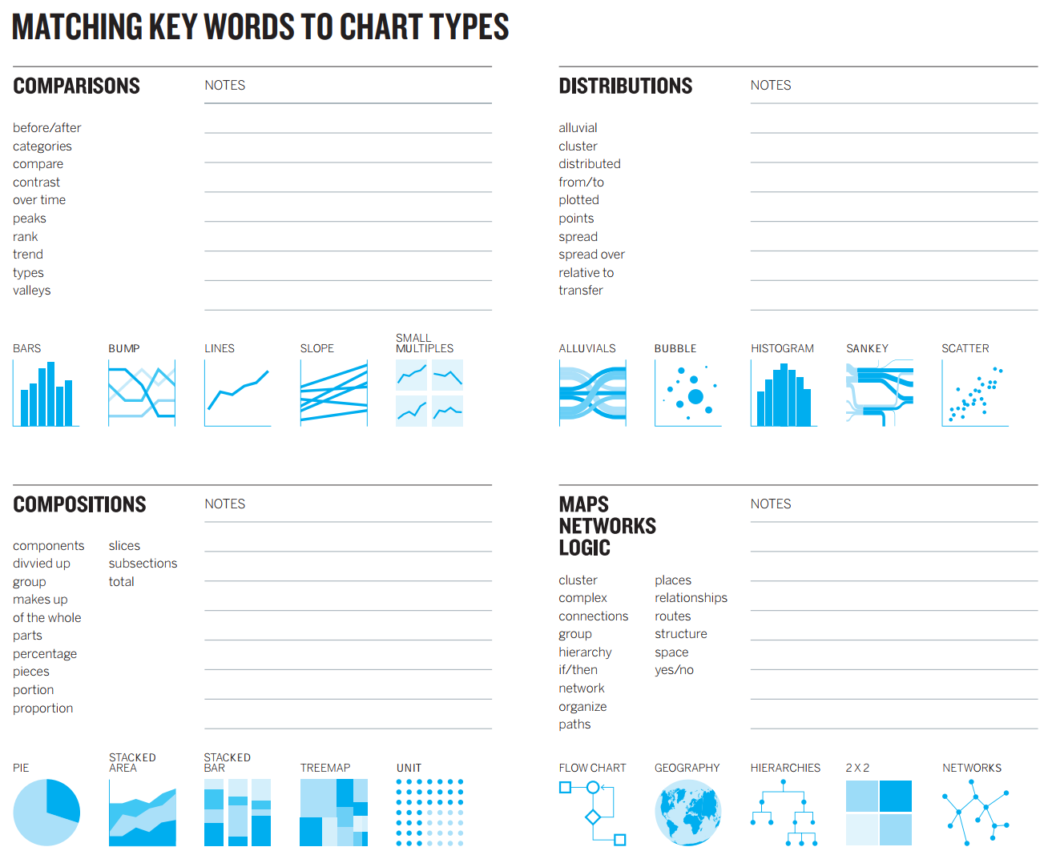
Messages vs. Chart types
HBR: Good Charts

Slide 38
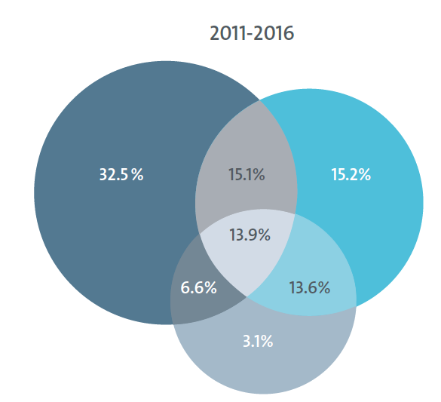
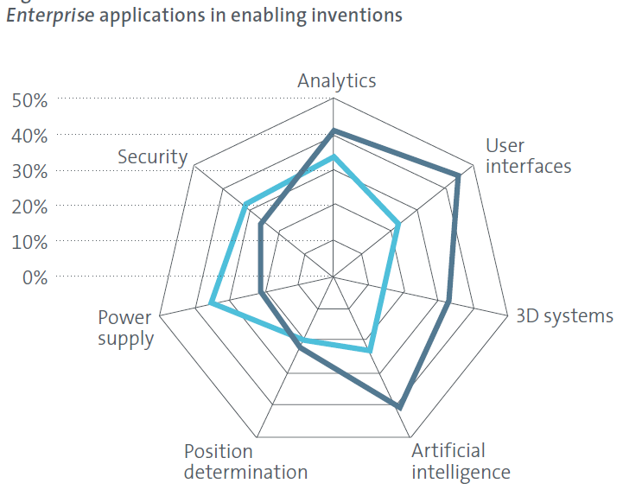

Visualization trends
Venn Diagrams
Spider /polar
User-friendly?
Who is your analysis recipient?

Slide 39
What are the risks of patent analysis?
Insufficient data leading to wrong results – importance of good data and adequate databases
Wrong results and assumptions – importance of a good methodology
Irrelevant data and analysis to the important questions/decisions to be taken – importance of good and relevant questions, and choice of data to analyze
Poor or misleading visualizations – the importance of adequate and meaningful visualizations
Lost in data! Not clearly communicated findings and messages – importance of good communication skills
Data as such have no value if not contextualized and interpreted correctly – the importance of a good patent analyst

Slide 40
Remember
What makes your analysis interesting? What do you want to highlight?
Experiment with visualizations and combination of dimensions to analyze (but: carrelation ≠ causation)
Don’t overdo it with the number of dimensions (avoid more than 3!)
Meaningful, effective and user-friendly visualizations: the power of simplicity!
Watch out for misleading conclusions or visualizations!
You are the added-value in the analysis, visualizations are just support tools!

Slide 41
Irene.Kitsara@wipo.int

